Slide 1


Project Title “Four Machine Learning Algorithm Visualization”
Submitted By:
Submitted TO:
Dr. Achala Shakya
Name | Sap Id
Deepanshu Bansal | 500107573
Jaskaran Singh Oberoi | 500107155
Aaditya Gaurav | 500107112
Subject: Predictive Analysis
Batch: B-1 AIML(H)

Slide 2



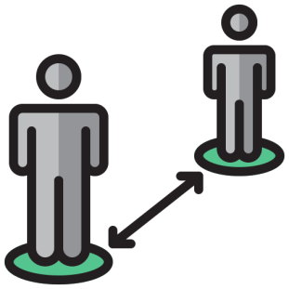

Introduction
This project focuses on visualizing four key machine learning algorithms—Logistic Regression, K-Nearest Neighbors (KNN), Support Vector Machine (SVM), and Density-Based Spatial Clustering of Applications with Noise (DBSCAN). The goal is to provide an intuitive understanding of how these algorithms work by showcasing their behavior on various datasets. The front-end is built using Streamlit, enabling an interactive user experience, while the back-end leverages popular libraries like numpy, pandas, matplotlib, sklearn, and pickle for data processing, algorithm implementation, and model persistence. This project bridges the gap between theory and practice by making complex machine learning concepts more accessible.

Slide 3
Visualization of Algorithm with Some Steps
Import basic library
Dataset load
Basic streamlit button, box, sidebars
Creating functions for algorithm
Result

Slide 4




Four Machine Learning Algorithm
Logistic Regression
K-nearest neighbor
Support Vector Machine
Density-Based Spatial Clustering of Application with Noise
Logistic regression is a statical method used for binary classification that models the probability of a given outcome using a logistic function.
K-nearest neighbor is used to calculate distance by each dataset point(or row) and according k value check nearest point and then check highest count class by selected points.
Support Vector Machine is a supervised learning algorithm used for classification and reg- ression, which find the hyperplane that best separates data into different classes.
DBSCAN is a density-based clustering algo-rithm that groups nearby points into clusters and identifies outliers in low-density regions.

Slide 5
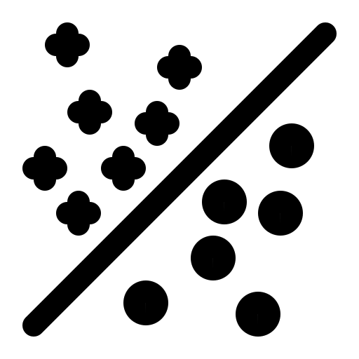
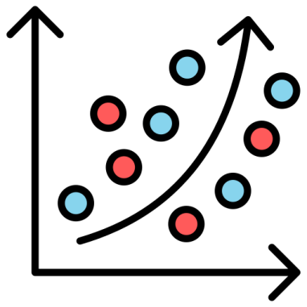
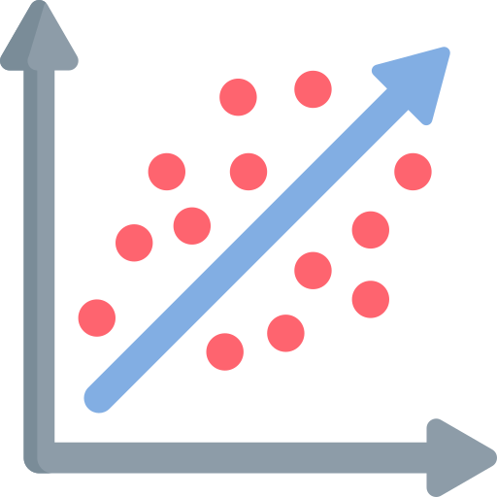
1. Logistic Regression
Logistic Regression is a supervised machine learning algorithm used for binary classification tasks, where the goal is to predict one of two possible outcomes (e.g., yes/no, true/false, 0/1).
Project uses and needs
Libraries: Streamlit, numpy, matplotlib, sklearn, make_blobs, LogisticRegression, train_test_split, accuracy_score
Streamlit: Markdown, subheader, selectbox, number_input, button, write, pyplot
Function: Create dataset, meshgrid(to draw graph), contour
Parameters: Penalty, C, Solver, Iteration, Multi_Class, L1_Ratio

Slide 6
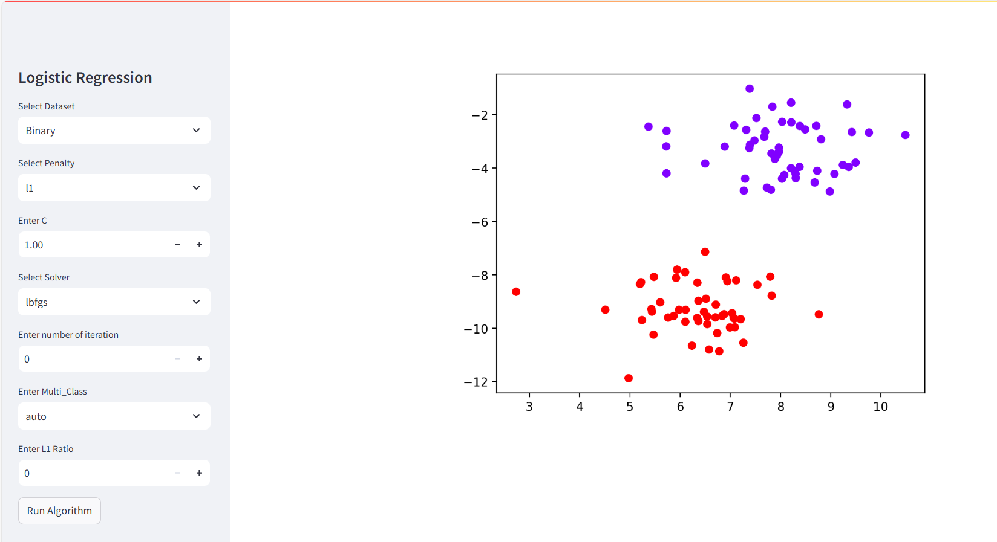
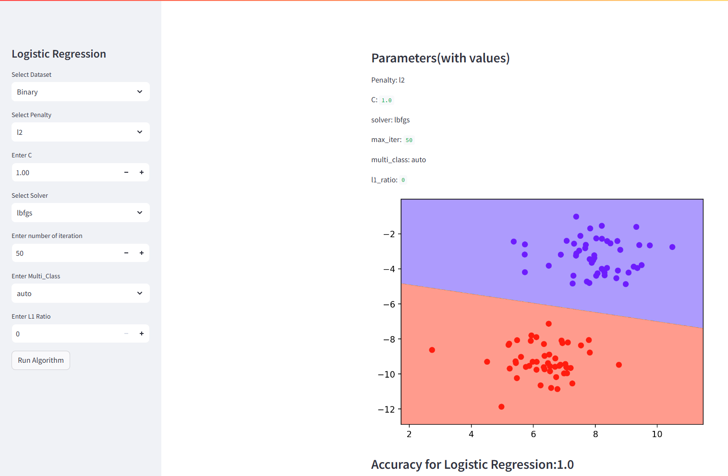
Front Interface

Slide 7
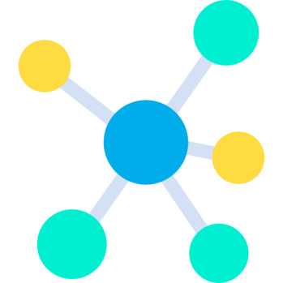
2. K-nearest neighbor
KNN (K-Nearest Neighbors) is a non-parametric algorithm that classifies data points based on the majority class of their K closest neighbors in the feature space. It can also predict values by averaging the outputs of its K nearest neighbors.
Project uses and needs
Libraries: Streamlit, numpy, pandas, pickle
Streamlit: Markdown, subheader, selectbox, number_input, button, write, pyplot
Type of Dataset
Iris Dataset
Wine Quality Dataset
Placement Dataset
Student Performance Dataset

Slide 8
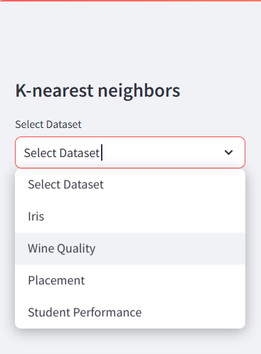
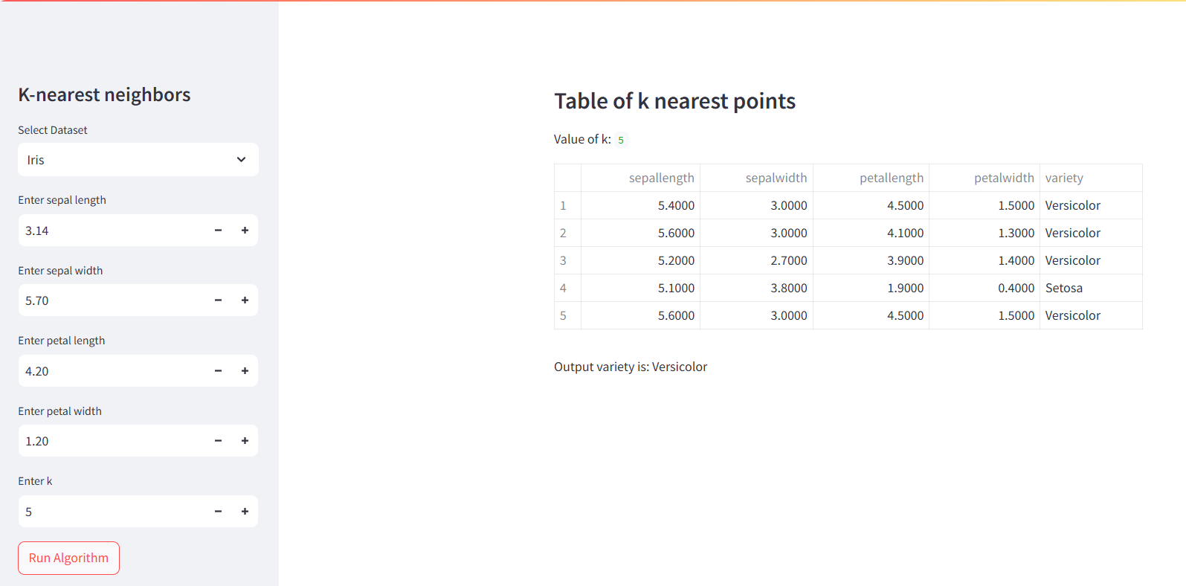
Front Interface

Slide 9
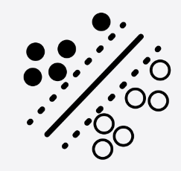

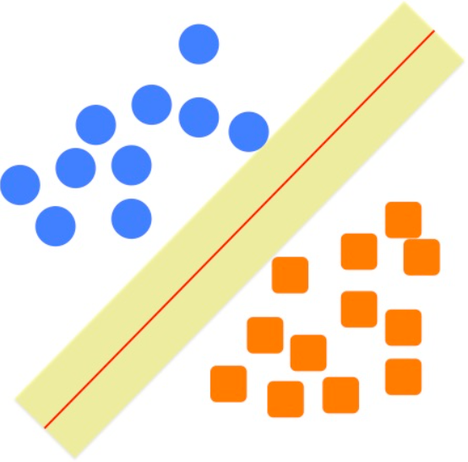
3. Support Vector Machine
Support Vector Machine (SVM) is a supervised learning algorithm that finds the optimal hyperplane to separate data points of different classes in a high-dimensional space. It maximizes the margin between the closest data points (support vectors) of each class to enhance classification accuracy.
Project uses and needs
Libraries: Streamlit, numpy, matplotlib, sklearn, make_blobs, SVC
Streamlit: Markdown, subheader, selectbox, number_input, button, write, pyplot
Function: graph
Parameters: C, kernel, gamma, coef0, shrinking, probability, verbose, max_iter, decision_function_shape

Slide 10
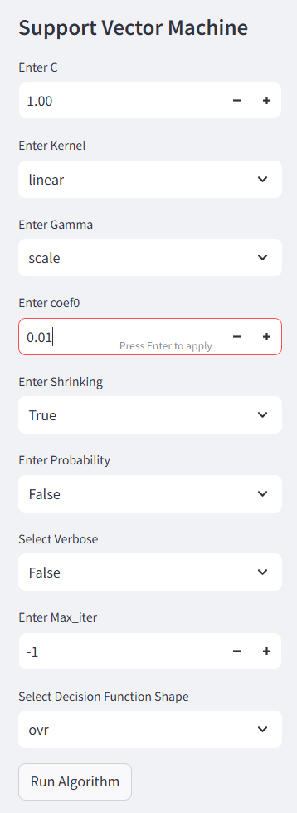
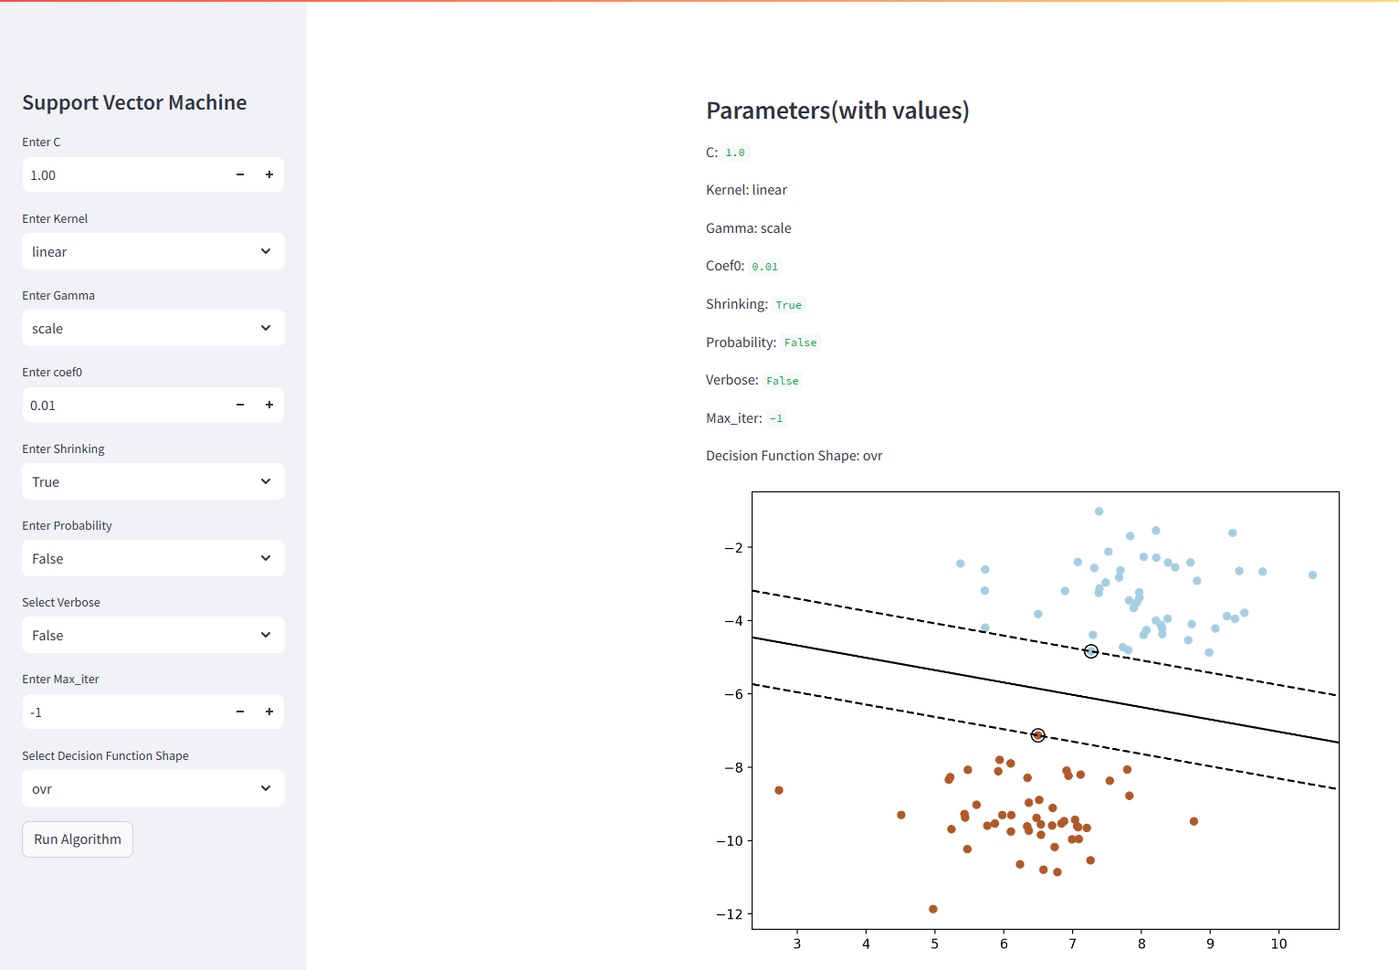
Front Interface

Slide 11
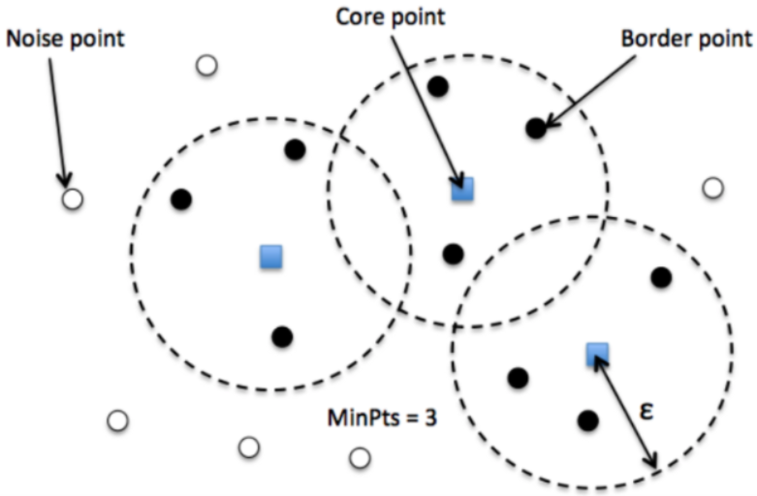
4. Density-Based Spatial Clustering of Applications with Noise
DBSCAN (Density-Based Spatial Clustering of Applications with Noise) is a clustering algorithm that groups together points that are closely packed while marking points in low-density regions as outliers. It defines clusters based on the density of data points, requiring a minimum number of points within a specified radius to form a cluster.
Project uses and needs
Libraries: Streamlit, numpy, matplotlib, sklearn, load_iris, make_blobs, make_moons, make_circles, DBSCAN, StandardScaler
Streamlit: Markdown, subheader, selectbox, number_input, button, write, pyplot
Parameters: eps, min_samples, metric, metric_params, algorithm, leaf_size, p, n_jobs
Type of Dataset
load_iris
make_moons
make_circles
make_blobs

Slide 12
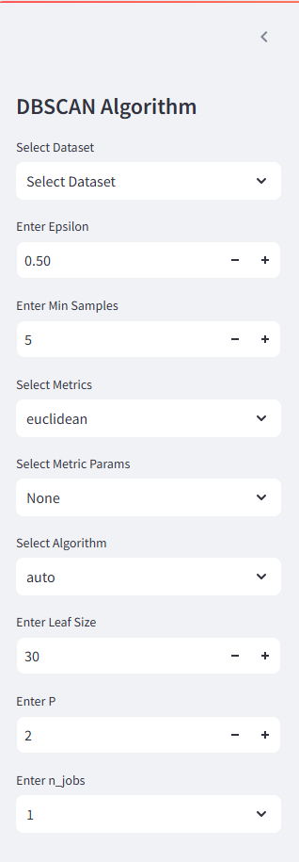
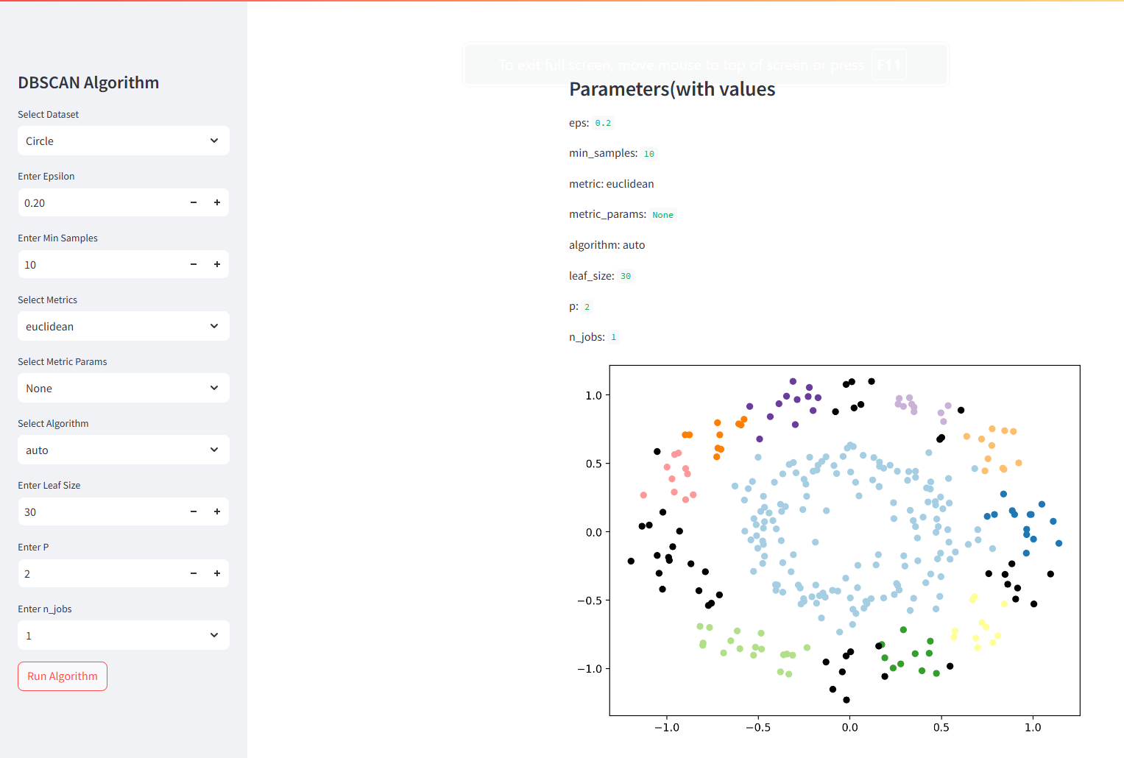
Front Interface

Slide 13
Thank You

